Slide 1
White box testing concepts
Satish Mishra
mishra@informatik.hu-berlin.de

Slide 2
This session
White box testing
Unit testing concepts for C/C++/.Net etc
  Unit testing tools
Testing related terms
  Memory Leak
  Test/Code Coverage
  Performance Profiler
  Dynamic test
Brief demo of professional testing tool
  Cantata++
Discussions
  Always welcome

Slide 3
Status of assignments
Doubts ?
Progress ! !
Results ??
Suggestions

Slide 4
White box testing
Also known as glass box, structural, clear box and open box testing. A software testing technique whereby explicit knowledge of the internal workings of the item being tested are used to select the test data.
For a complete software examination, both white box and black box tests are required

Slide 5
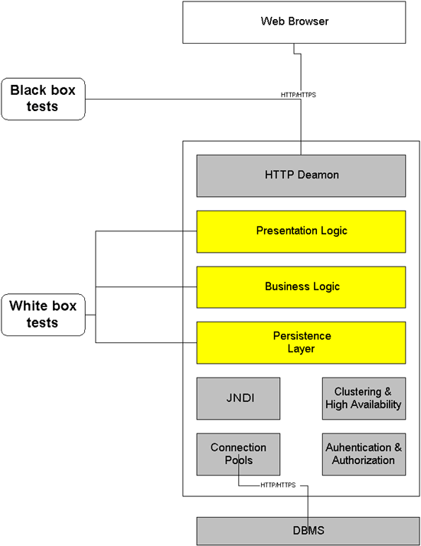
White Box and Black Box tests interface to an application

Slide 6
Unit testing
How to test the programs of different technology ?
C
C++
Microsoft technologies VB/.Net
Web related (PHP,ASP,JSP..etc.)
How to do unit testing of above technologies ?

Slide 7
Unit test tools
AdaTEST
AQtest
Aunit
C++Test
Cantata
Check
COMPUTE
CppUnit
csUnit
CTA++
CTB
cUnit
CUT
dotunit
EasyMock
GrandTestAuto
HarnessIt
HtmlUnit
HttpUnit
JavaScript
JsUnit
JsUnit
JTestCase
JUnit
JUnitEE
JUnitX
LingoUnit
MinUnit
Mock Creator
Mock Objects
MockMaker
Mockry
NUnit
ObjcUnit
OCUnit
OTF - An
PalmUnit
PBUnit
PerlUnit
phpAsserUnit
PhpUnit
PyUnit
QtUnit
Ruby/Mock
SUnit
TagUnit
TBGEN
TBrun
Test Mentor - Java Edition
unit++
vbUnit3 Basic
VectorCAST
XMLUnit
XSLTunit
http://www.testingfaqs.org/t-unit.htm

Slide 8
Testing related terms
Memory Leak
Test/Code Coverage
Performance Profiler
Dynamic test

Slide 9
What is memory leak
What
  Allocating memory without releasing later
Why bad
  Reduce performance
  May cause crashes
How to solve
  Find out where exactly memory is leaked

Slide 10
C/C++ memory leak
In C/C++, it is possible to allocate space for objects (variables) dynamically during program execution. After finishing use of a dynamically allocated object, it is necessary to explicitly release the memory consumed by the object, particularly before pointers to the object go out of scope.

Slide 11
Memory leak example
When a variable is created by a “usual declaration”, i.e., without new, memory is allocated on the “stack”.
  {
  int i = 3; // memory for i and obj
  MyObject obj; // allocated on the stack
  ...
  }
  So when we delete them ??
When the variable goes out of scope, its memory is automatically deallocated (“popped off the stack”).
// i and obj go out of scope,
// memory freed

Slide 12
Memory leak example...
To allocate memory dynamically, we first create a pointer, e.g.,
MyClass* ptr;
ptr itself is a variable on the stack. Then we create the object:
ptr = new MyClass( constructor args );
This creates the object (pointed by ptr) from a pool of memory called the “heap” (or “free store”).
When the object goes out of scope, ptr is deleted from the stack, but the memory for the object itself remains allocated in the heap:
{
MyClass* ptr = new MyClass(); // creates object….. …
} // ptr goes out of scope here -- memory leak!

Slide 13
Memory leak example...
To prevent the memory leak, we need to deallocate the object’s memory before it goes out of scope:
{
MyClass* ptr = new MyClass(); // creates an object
MyClass* a = new MyClass[n]; // array of objects
...
delete ptr; // deletes the object pointed to by ptr
delete [] a; // brackets needed for array of objects
}
For every new, there should be a delete.
For every new with brackets [], there should be a delete []

Slide 14
Test/Code coverage
Precondition
  Software product under development
  Test suite
Test / Code coverage provides a measure of how well test suite actually tests the product.

Slide 15
Test/Code coverage analysis
Coverage analysis is a way of measuring how much of the code has been exercised during testing
Coverage analysis can be used to determine when sufficient testing has been carried out
Coverage analysis can identify unexecuted code structures
  Add more test cases?
  Remove dead or unwanted code!
An optional aspect is:
Identifying redundant test cases that do not increase coverage

Slide 16
Test/Code coverage – examples
Statement Decision Path coverage
?
?
?
1 2 4 test cases

Slide 17
Type of coverage
Statement coverage
Basic block coverage
Decision coverage
Condition coverage
Branch coverage
Loop coverage

Slide 18
Exercise for test coverage
* We should try now..

Slide 19
#include <iostream.h>
int main(void) {
int nDependents, Exemption;
float Income, TaxSubTotal, TaxTotal;
cout << "Welcome to tax calculator. Enter your yearly income: ";
cin >> Income;
// first if - check income
if (Income < 0) {
cout << "You cannot have a negative income.\n";
return 0;
}
cout << "Enter the number of dependents you have, including yourself: ";
cin >> nDependents;
// second if - check dependents
if (nDependents <= 0) {
cout <<"You must have at least one dependent.\n";
return 0;
}
// third if (else-if) - compute tax subtotal
if (Income < 10000)
TaxSubTotal = .02 * Income;
else if (Income < 50000)
TaxSubTotal = 200 + .03 * (Income - 10000);
else
TaxSubTotal = 1400 + .04 * (Income - 50000);
Exemption= nDependents * 50;
TaxTotal=TaxSubTotal - Exemption;
// last if - check negative tax
if (TaxTotal<0) //In case of negative tax
TaxTotal=0;
cout << „Result of Tax \n";
cout << "Tax Bill \n";
cout << " Citizen's Income: " << Income <<'\n';
cout << " Tax Subtotal: " << TaxSubTotal << '\n';
cout << "Number of Dependents: " << nDependents << '\n';
cout << " Tax Exepmtion: " << Exemption << '\n';
cout << " Final Tax Bill: " << TaxTotal << '\n';
}

Slide 20
First if | Second if | If-else-if | Last if | Result
Income < 0 | doesn't matter | doesn't matter | doesn't matter | negative income error
Income >= 0 | NDependents <= 0 | doesn't matter | doesn't matter | invalid dependents error
Income >= 0 | NDependents > 0 | Income < 10000 | TaxTotal < 0 | bracket 1 negative tax
Income >= 0 | NDependents > 0 | 10000 <= Income < 50000 | TaxTotal < 0 | bracket 2 negative tax
Income >= 0 | NDependents > 0 | Income >= 50000 | TaxTotal < 0 | bracket 3 negative tax
Income >= 0 | NDependents > 0 | Income < 10000 | TaxTotal >= 0 | bracket 1
Income >= 0 | NDependents > 0 | 10000 <= Income < 50000 | TaxTotal >= 0 | bracket 2
Income >= 0 | NDependents > 0 | Income >= 50000 | TaxTotal >= 0 | bracket 3

Slide 21
Test Cases for this example
Income | NDependents | Expected Result
-5 | Doesn't matter | negative income error
0 | 0 | invalid dependents error
100 | 1 | 0 (bracket 1, negative tax)
20000 | 11 | 0 (bracket 2, negative tax)
50000 | 100 | 0 (bracket 3, negative tax)
9000 | 1 | 130 (bracket 1)
15000 | 1 | 300 (bracket 2)
100000 | 1 | 3350 (bracket 3)

Slide 22
Coverage analysis tools:
Bullseye Coverage
Cantata++
CodeTEST
LOGISCOPE
Panorama C/C++
Rational PureCoverage
TCAT C/C++
GCT
Reference: http://testingfaqs.org/t-eval.html

Slide 23
Performance profiler
Code profiling is the process of benchmarking the execution to understand where the time is being spent in terms of code execution
Which lines of code are responsible for the bulk of execution time?
How many times is this looping construct executed?
Which approach to coding a block of logic is more efficient?
  Without profiling, the answer to the above questions becomes a guessing game.

Slide 24
Facts of profiler
Why/When we need ?
Profiler will pinpoint slow code and allow us to drill down to examine it, so code can be optimized and performance can be improved
How it works ?
Profiler runs while we are using our application and records the frequency and time spent in each line of code

Slide 25
What is dynamic test
requirements
+ design docs
document verification
V&V
report
static analysis
SUT
software
under
test
test-
class
test
case
test
results
dynamic test

Slide 26
C /C++ testing tool
Professional Software
Testing Tools Cantata++
(Tools brief presentation)

Slide 27
Overview Cantata++
Dynamic Testing
  Executing the software
  Under known conditions
  Verifying results against expected outcomes
Code Coverage
Integration Testing
Host-Target Testing
Static Analysis metrics
Generation of code metrics
  Does source code meets quality and maintainability standards?
Cantata++ for C and Cantata++ for C++ are two very common industry accepted tools for testing

Slide 28
Unit testing features
Wizard driven template test script generation
Automated checking of expected results
Black / White box techniques
Simulation of external software (Stubs)
State transition testing
Real-time performance analysis
Automated regression testing

Slide 29
Integration testing additional features
Total control over external interfaces (Wrapping)
Call sequence validation
User observation tests
Mulit-threaded test execution

Slide 30
Overview - Aims
Repeatable
Automatic
Auditable
Portable
Measurable
Productive and Efficient

Slide 31
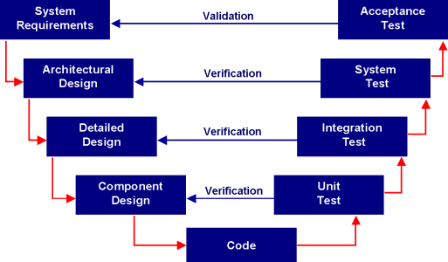

Overview – Software Lifecycle
Software development follows a life-cycle model. The V-Model is a useful example, but there are many different life-cycles.
Cantata++ can be used at all stages of the lifecycle

Slide 32
How stubbing works
  Cantata++ Creates a Stub function containing programmable instances for the external object, which are called by the source code under test and replace the original external object (software, firmware or hardware)

Slide 33
Overview – Dynamic Testing
Host and Target testing
  Test on development platform and in the target environment
Regression testing
  Automated re-execution of tests
White-box and Black-box testing
  Testing with and without knowledge of the code
Isolation testing
  Testing with simulation of external code interfaces

Slide 34
Overview – Coverage Analysis
Measure and report coverage
Set a Pass/Fail coverage checks for your project
Metrics supported include:
  Entry-Points
  Statements
  Decisions
  Conditions

Slide 35
Overview – Static Analysis
Derives metrics from the source code to help improve its quality
Output data in CSV format for
  Numerical or graphical analysis
Provide objective data for
  Code reviews, project management, end of project statistics
Provide facilities to generate up to 300 source code metrics
  Code construct counts, Complexity metrics, File metrics

Slide 36
How cantata++ works
Source
Code
Pass/Fail
reports
Template test
Script
Populated test Script
make
(compile
cpp & link)
Test
Exe
Reports
summary
Test script wizard
Reports
files
C/C++
libraries
Cantata++
libraries

Slide 37
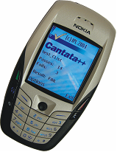






Cantata++ Customers
Train Control - Alcatel
Medical Systems – GE Medical
Cantata++ running under Symbian – Nokia Series 60
Nuclear Reactor Control - Thales
EFA Typhoon – BAe Systems
International Space Station – Dutch Space
Airbus A340 – Ultra Electronics

Slide 38
Further Information
http://www.iplbath.com

Slide 39
Tool Summary
Objective test strategy should achieve
“an acceptable level of confidence
at an acceptable level of cost”.
Tests should be
  Planned for in the project
  Against specified requirements
  As automated and repeatable as possible
  Maintainable

Slide 40
Summary of testing
Verify operation at normal parameter values
  (a black box test based on the unit’s requirements)
Verify operation at limit parameter values
  (black box)
Verify operation outside parameter values
  (black box)
Ensure that all instructions execute
  (statement coverage)
Check all paths, including both sides of all branches
  (decision coverage)

Slide 41
Summary of testing
Check the use of all called objects
Verify the handling of all data structures
Verify the handling of all files
Check normal termination of all loops
  (part of a correctness proof)
Check abnormal termination of all loops

Slide 42
Summary of testing
Check normal termination of all recursions
Check abnormal termination of all recursions
Verify the handling of all error conditions
Check timing and synchronization
Verify all hardware dependencies
Statements of (Watts Humphrey)

Slide 43
The End
Thank You

